Slide 1
CSC 112: Computer Operating Systems Lecture 6 Real-Time Scheduling I
Department of Computer Science,
Hofstra University
Acknowledgement: Lecture slides based on Buttazzo, Hard Real-Time Computing Systems

Slide 2
Outline
Introduction to RTOS and Real-Time Scheduling
Fixed-Priority Scheduling
Earliest Deadline First Scheduling
Least Laxity First (LLF) Scheduling
Preemptive vs. Non-Preemptive Scheduling
Multiprocessor Scheduling
Resource Synchronization Protocols (for Fixed-Priority Scheduling)

Slide 3
Introduction to RTOS and Real-Time Scheduling

Slide 4
Embedded Control Systems
An embedded control system co´nsists of:
The system-under-control (SUT)
may include sensors and actuators
The controller/computer
sends signals to the system according to a predetermined control objective
In the old days, each control task runs on a dedicated CPU
No RTOS, bare metal
No need for scheduling
Just make sure that task execution time < deadline
Now, multiple control tasks share one CPU
Multitasking RTOS
Need scheduling to make sure all tasks meet deadlines
D/A
actuators
SUT
A/D
sensors
Controller/computer
Thread or process (task)
Resource

Slide 5
Requirements
The tight interaction with the environment requires the system to react to events within precise timing constraints
Timing constraints are imposed by the dynamics of the environment
The real-time operating system (RTOS) must be able to execute tasks within timing constraints

Slide 6
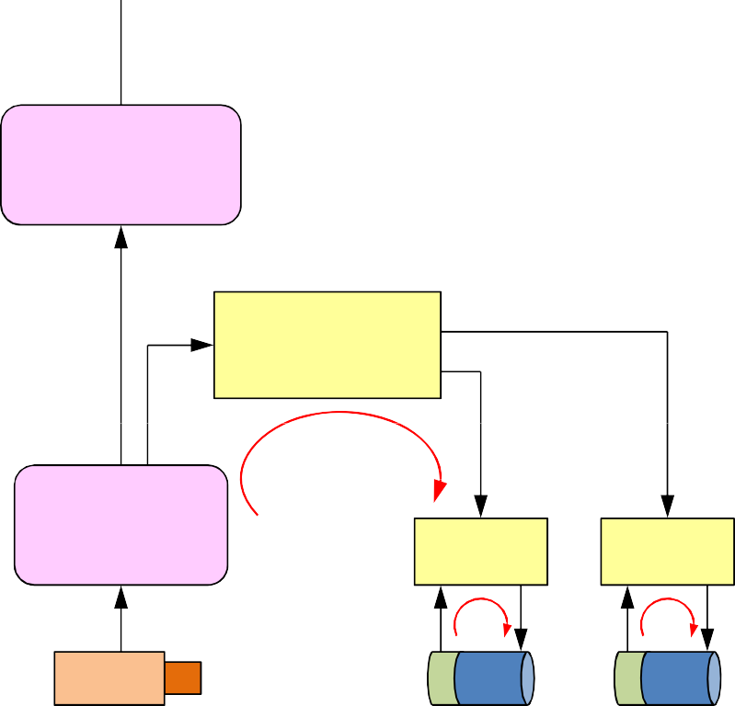
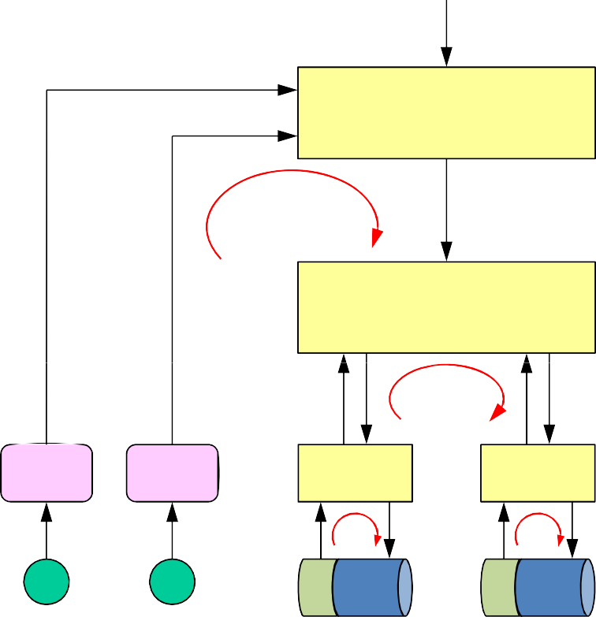





A Robot Control Example
Consider a robot equipped with:
two actuated wheels
two proximity (US) sensors
a mobile (pan/tilt) camera
a wireless transceiver
Goal:
follow a path based on visual feedback
avoid obstacles
visual−based navigation
100 ms
obstacle avoidance
object recognition
10 ms
visual tracking
vehicle control
5 ms
feature extraction
20 ms
motor control
motor control
1 ms
motor control
motor control
1 ms
camera
pan
tilt
US1 US2
mot_dx
mot_sx
Notes:
send complete robot status every 20 ms

Slide 7


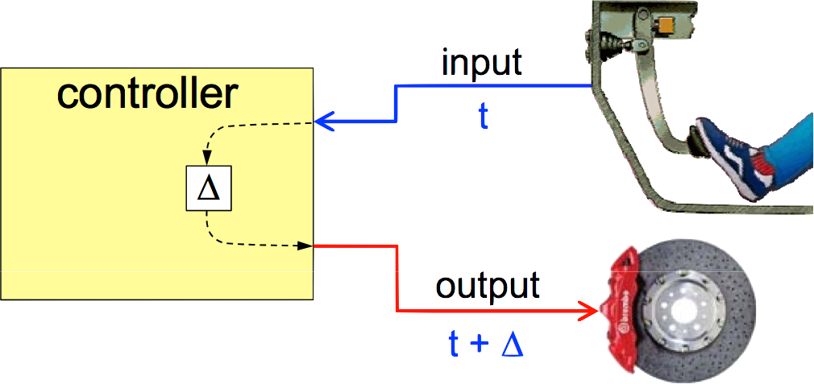
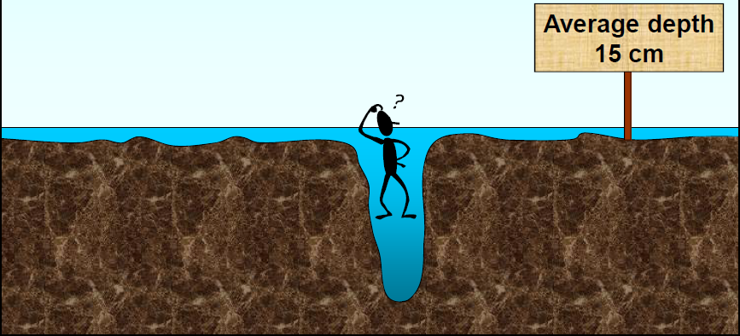
Real-Time Systems
A computer system that is able to respond to events within precise timing constraints
A system where the correctness depends not only on the output values, but also on the time at which results are produced
A real-time system is not a necessarily a real fast system
Speed is always relative to a specific environment
Running faster is good, but does not guarantee hard real-time constraints
The objective of a real-time system is to guarantee the worst-case timing behaviour of each individual task
The objective of a fast system is to optimize the average-case performance
A system with fast average-case performance may not meet worst-case timing requirements
Analogy: there was a person who drowned in a river with average depth of 15 cm
x (t)
RT system Environment
t
y (t+Δ)
Notes:
response time of a task set.

Slide 8
RTOS Requirements
Timeliness: results must be correct not only in their value but also in the time domain
provide kernel mechanism for time management and for handling tasks with explicit timing constraints and different criticality
Predictability: system must be analyzable to predict the consequences of any scheduling decision
if some task cannot be guaranteed within time constraints, system must notify this in advance, to handle the exception (plan alternative actions)
Efficiency: operating system should optimize the use of available resources (computation time, memory, energy)
Robustness: must be resilient to peak-load conditions
Fault tolerance: single software/hardware failures should not cause the system to crash
Maintainability: modular architecture to ensure that modifications are easy to perform

Slide 9
Sources of Nondeterminism
Architecture
cache, pipelining, interrupts, DMA
Operating System (our focus in this lecture)
scheduling, synchronization, communication
Language
lack of explicit support for time
Design Methodologies
lack of analysis and verification techniques

Slide 10



Task
The concept of concurrent tasks reflects the intuition about the functionality of embedded systems.
Task here can refer to either process or thread, depending on the underlying RTOS support
Tasks help us manage timing complexity:
multiple execution rates
multimedia
automotive
asynchronous input
user interfaces
communication systems
activation time a_{i}
Task τ_{i}
start time s_{i}
Execution time C_{i}
finish time f_{i}
activation
Ready queue
τ₃ τ₂ τ₁
dispatching termination
CPU
“activation” = “arrival” = “release” time

Slide 11
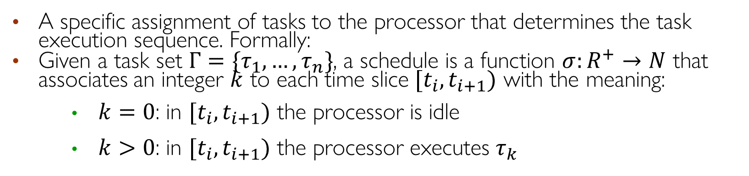
Schedule
A specific assignment of tasks to the processor that determines the task execution sequence. Formally:
Given a task set $Γ=\{τ_{1},…,τ_{n}\}$, a schedule is a function $σ:R^{+}→N$ that associates an integer $k$ to each time slice $[t_{i},t_{i+1})$ with the meaning:
$k=0$: in $[t_{i},t_{i+1})$ the processor is idle
$k>0$: in $[t_{i},t_{i+1})$ the processor executes $τ_{k}$
idle
τ₁ τ₂ τ₃
idle
σ(t)
3
2
1
0
t₁ t₂
t₃
t₄
t
At times t₁, t₂,…: context switch to a different task
Notes:
Deciding the order of a set of tasks with certain known characteristics (periodicity, execution time) on a limited set of processing units, subject to a set of constraints on the completion time of each task.

Slide 12
Preemptive vs. Nonpreemptive Scheduling
A scheduling algorithm is:
preemptive: if the active job can be temporarily suspended to execute a more important job
non-preemptive: if the active job cannot be suspended, i.e., always runs to completion
priority
τ₁
τ₂
τ₃
0
2
4
6
8 10 12 14 16 18 20
σ(t)
3
2
1
0
0
2
4
6
8 10 12 14 16 18 20
Preemptive scheduling example
Notes:
● + Exception handling: timely response to issues
Different levels of importance or criticality: preemption executes most critical tasks
Running tasks may be suspended and placed in the ready queue

Slide 13
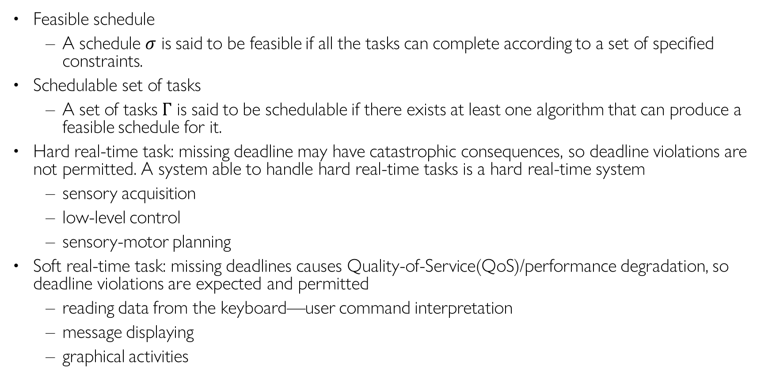
Definitions
Feasible schedule
A schedule $σ$ is said to be feasible if all the tasks can complete according to a set of specified constraints.
Schedulable set of tasks
A set of tasks $Γ$ is said to be schedulable if there exists at least one algorithm that can produce a feasible schedule for it.
Hard real-time task: missing deadline may have catastrophic consequences, so deadline violations are not permitted. A system able to handle hard real-time tasks is a hard real-time system
sensory acquisition
low-level control
sensory-motor planning
Soft real-time task: missing deadlines causes Quality-of-Service(QoS)/performance degradation, so deadline violations are expected and permitted
reading data from the keyboard—user command interpretation
message displaying
graphical activities
Notes:
Deciding the order of a set of tasks with certain known characteristics (periodicity, execution time) on a limited set of processing units, subject to a set of constraints on the completion time of each task.
Hard Real-Time System if it can handle hard tasks
HARD tasks
All jobs must meet their deadlines. Missing deadlines may cause catastrophic consequences.
e.g., sensor reading, motor control.
SOFT tasks
Missing deadlines is not desirable but causes only Quality-of-Service(QoS) degradation.
e.g., reading data from keyboard, user command interpretation, message display
A system able to handle HARD tasks is a hard real-time system

Slide 14
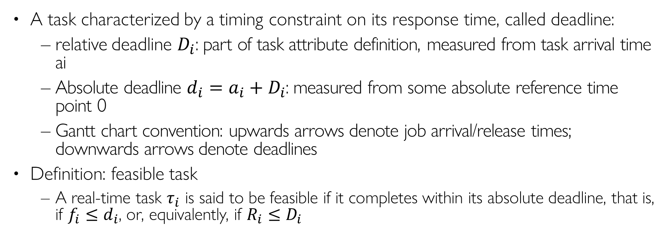
Real-Time Task
A task characterized by a timing constraint on its response time, called deadline:
relative deadline $D_{i}$: part of task attribute definition, measured from task arrival time ai
Absolute deadline ${d_{i}=a_{i}+D}_{i}$: measured from some absolute reference time point 0
Gantt chart convention: upwards arrows denote job arrival/release times; downwards arrows denote deadlines
Definition: feasible task
A real-time task $τ_{i}$ is said to be feasible if it completes within its absolute deadline, that is, if $f_{i}≤d_{i}$, or, equivalently, if $R_{i}≤D_{i}$
relative deadline D_{i}
τ_{i}
a_{i} s_{i}
response time R_{i}
f_{i}
t
d
i
absolute deadline (d_{i} = a_{i} + D_{i})
Notes:
“Completion time” = fi - si = Ri – (si- ai)

Slide 15
Tasks and Jobs
A task running several times on different input data generates a sequence of instances (jobs)
Upwards arrow: task arrival or release times; downwards arrow: task deadlines
Activation mode:
Periodic tasks: the task is activated by the operating system at predefined time intervals
Aperiodic tasks: the task is activated at an event arrival
Job 1
τi,1
Job 2
τi,2
Job 3
τi,3
Ci
τi
ai,1
ai,k
ai,k+1
t
Notes:
Time-driven

Slide 16


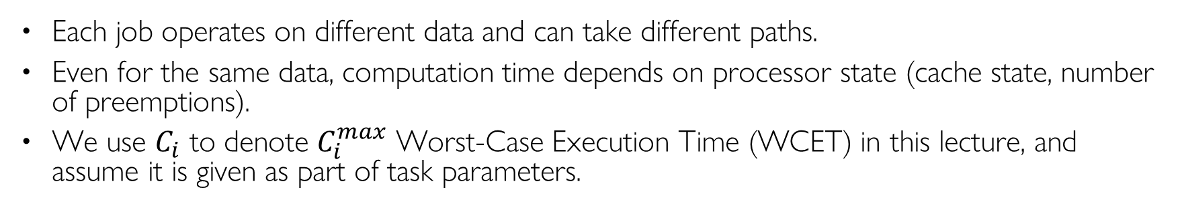
Estimating WCET is Not Easy
Each job operates on different data and can take different paths.
Even for the same data, computation time depends on processor state (cache state, number of preemptions).
We use $C_{i}$ to denote $C_{i}^{max}$ Worst-Case Execution Time (WCET) in this lecture, and assume it is given as part of task parameters.
?
loop
?
Distribution
(probability density function)
?
timer
min
max
execution time
C_{i}
C_{i}

Slide 17
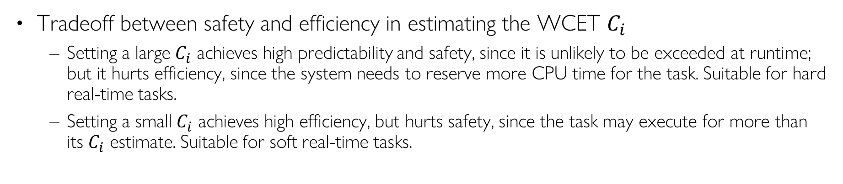
Predictability/Safety vs. Efficiency
Tradeoff between safety and efficiency in estimating the WCET $C_{i}$
Setting a large $C_{i}$ achieves high predictability and safety, since it is unlikely to be exceeded at runtime; but it hurts efficiency, since the system needs to reserve more CPU time for the task. Suitable for hard real-time tasks.
Setting a small $C_{i}$ achieves high efficiency, but hurts safety, since the task may execute for more than its $C_{i}$ estimate. Suitable for soft real-time tasks.
Distribution
(probability density function)
execution time
C_{i}
min
C_{i}
avg
C_{i}
max
C_{i} estimate
unsafe
efficient
safe
Notes:
where deadline violations may cause severe consequencesIt is a parameter related to the consequences of missing the deadline
Hard: missing deadline may have catastrophic consequences
Hard Real-Time System if it can handle hard tasks
sensory acquisition
low-level control
sensory-motor planning
Soft: missing a deadline causes performance degradation
reading data from the keyboard—user command interpretation
message displaying
graphical activities
Value, v_{i} = the relative importance of a task wrt other tasks

Slide 18
Jitter
It is a measure of the time variation of a periodic event:
Finish-time Jitter
τ_{i}
fi,1
fi,2
fi,3
Start-time Jitter
τ_{i}
si,1 si,2 si,3
Completion-time Jitter (I/O Jitter)
τ_{i}
si,1
fi,1
si,2
fi,2
si,3
fi,3
Notes:
max (t_{k} – a_{k}) – min (t_{k} – a_{k})
k k
max | (t_{k} – a_{k}) – (f_{k-1} – a_{k-1}) |

Slide 19

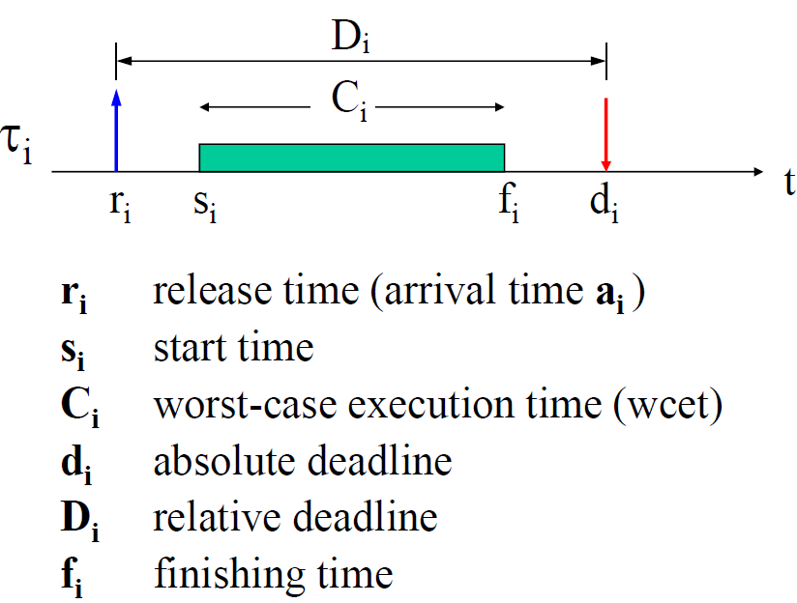

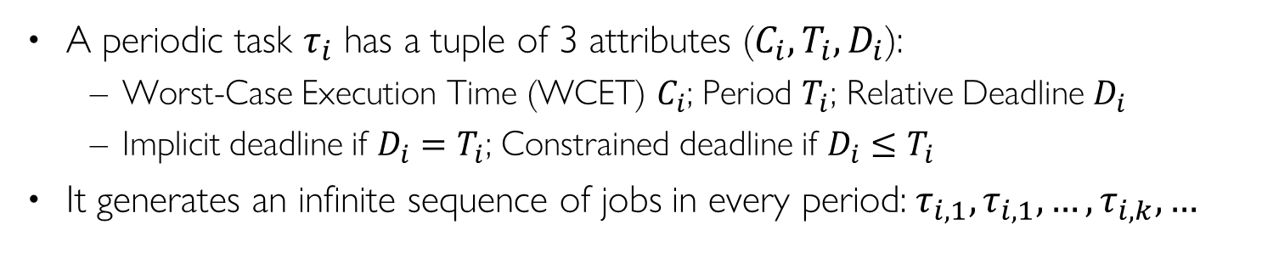

Periodic Task
A periodic task $τ_{i}$ has a tuple of 3 attributes ($C_{i}, T_{i}{, D}_{i}$):
Worst-Case Execution Time (WCET) $C_{i}$; Period $T_{i}$; Relative Deadline $D_{i}$
Implicit deadline if $D_{i}=T_{i}$; Constrained deadline if $D_{i}≤T_{i}$
It generates an infinite sequence of jobs in every period:$τ_{i,1},τ_{i,1},…,τ_{i,k}, …$
input
C
i
output
wait()
timer (period T_{i} )
τi (Ci , Ti , Di )
Ci
Ti
job τik
ai,1 = Φi
ai,k
ai,k+1
t
task phase or
Release offset
ai,k di,k
= Φi + (k−1) T_{i}
= a_{i,k} + D_{i}
often
Di = Ti
A job of task $τ_{i}$
Multiple jobs released by task $τ_{i}$
Notes:
Consider a periodic task τ₁(C₁,T₁,D₁) with phase Φ₁, where:
C₁ = 10 ms, T₁ = 50 ms, D₁ = 25 ms, and Φ₁ = 100 ms
What is τ₁’s utilization factor?
Is τ₁ feasible?
What is τ_{1,1}’s absolute deadline?
What is τ_{1,1}’s laxity?
What is τ_{1,2}’s release time?
Can τ_{1,1} and τ_{1,2} have different laxity?
Can τ_{1,1} and τ_{1,2} have different slack?
If τ_{1,2}’s slack is 10ms, what is τ_{1,s}’s finishing time?
What is τ_{1,2}’s response time?
With a 2-CPU machine, can τ_{1,2} and τ_{1,3} have the same release time?
Can τ_{1,2} and τ_{1,3} have the same finishing time?

Slide 20

Aperiodic & Sporadic Task
Aperiodic task: jobs may arrive at arbitrary time instants
Sporadic task: arrival times with a minimum interarrival time constraint
Aperiodic:
ai,k+1 > ai,k
minimum interarrival time
Sporadic:
ai,k+1
≥ a_{i,k} + T_{i}
job τik
τi
Ci
Ci
Ci
ai,1
ai,k
ai,k+1
t

Slide 21
Types of Constraints
Timing constraints
Deadline, jitter
Precedence constraints
Relative ordering among task executions
Resource constraints
Synchronization when accessing mutually-exclusive resources (shared data)

Slide 22














Precedence Constraints
stereo vision
Tasks must be executed with specific precedence relations, specified by a Directed Acyclic Graph (Precedence Graph)
Example application of parts inspection in a factory. Tasks:
Image acquisition (acq1, acq2)
Edge detection (edge1, edge2)
Shape detection (shape), pixel disparities (disp)
Height determination (height), recognition (rec)
processing
recognition
acq1
acq2
edge1
edge2
disp
shape
depth
rec
Notes:
Precedence graph?

Slide 23
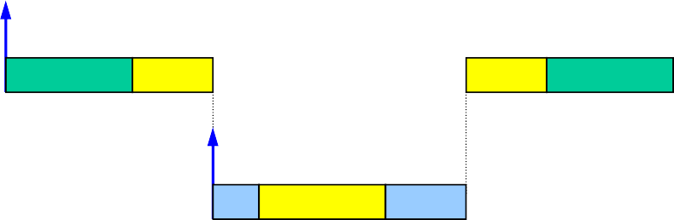
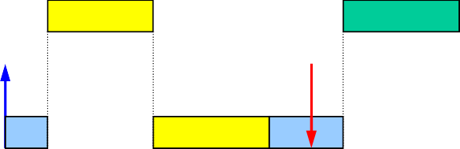
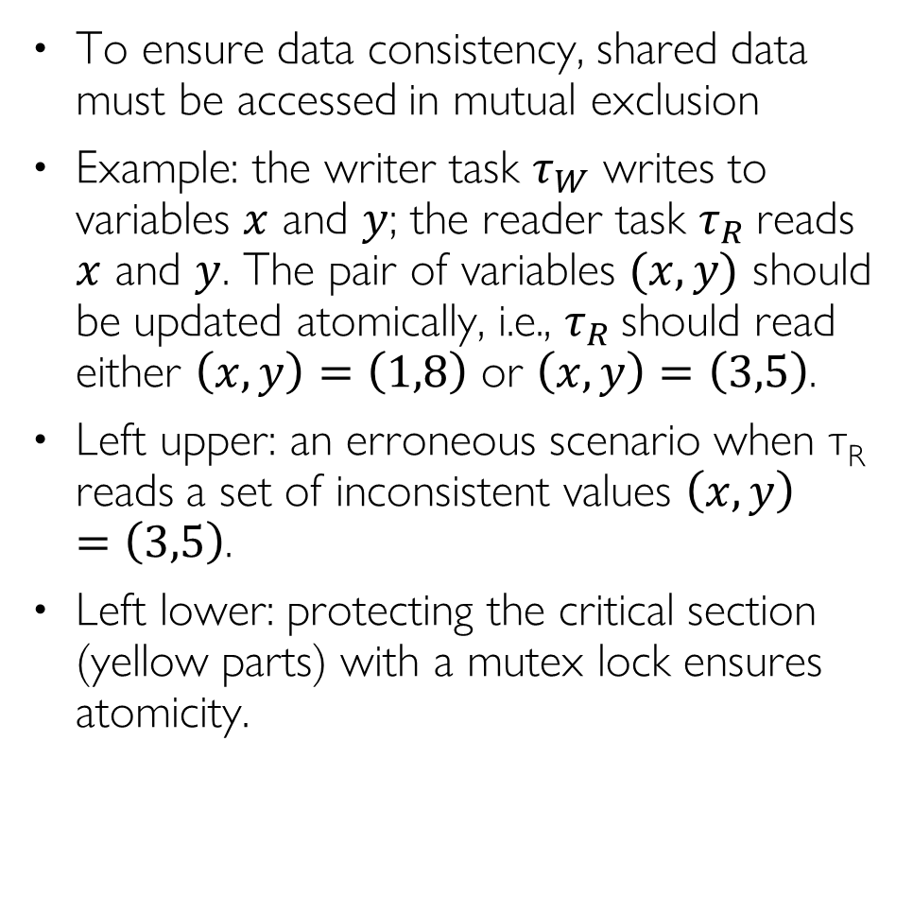
Resource Constraints
To ensure data consistency, shared data must be accessed in mutual exclusion
Example: the writer task $τ_{W}$ writes to variables $x$ and $y$; the reader task $τ_{R}$reads $x$ and $y$. The pair of variables $(x,y)$ should be updated atomically, i.e., $τ_{R}$ should read either $\left(x,y\right)=\left(1,8\right)$ or $\left(x,y\right)=\left(3,5\right)$.
Left upper: an erroneous scenario when τ_{R} reads a set of inconsistent values $\left(x,y\right)=\left(3,5\right)$.
Left lower: protecting the critical section (yellow parts) with a mutex lock ensures atomicity.
τ_{W}
x = 3
y = 5
τ_{R}
x = 1
y = 8
x = 1
y = 5
τ_{W}
τ_{R}
x=1
y=5
read
Erroneous scenario with no lock protection
τ_{W}
x = 3
y = 5
τ_{R}
x = 1
y = 8
x = 1
y = 8
τ_{W}
x = 1
y = 8
τ_{R}
read
Δ
Correct scenario with lock protection

Slide 24
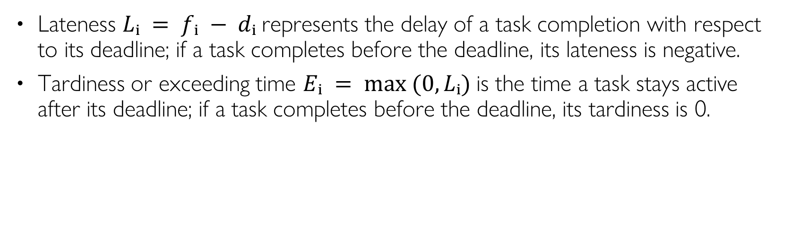
Scheduling Metrics
Lateness $Lᵢ = fᵢ − dᵢ$represents the delay of a task completion with respect to its deadline; if a task completes before the deadline, its lateness is negative.
Tardiness or exceeding time $Eᵢ = max ⁡(0, Lᵢ)$is the time a task stays active after its deadline; if a task completes before the deadline, its tardiness is 0.
Notes:
Using the above definitions, we have dᵢ ≥ rᵢ + Cᵢ

Slide 25
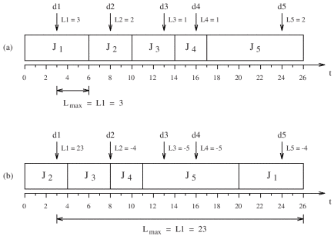
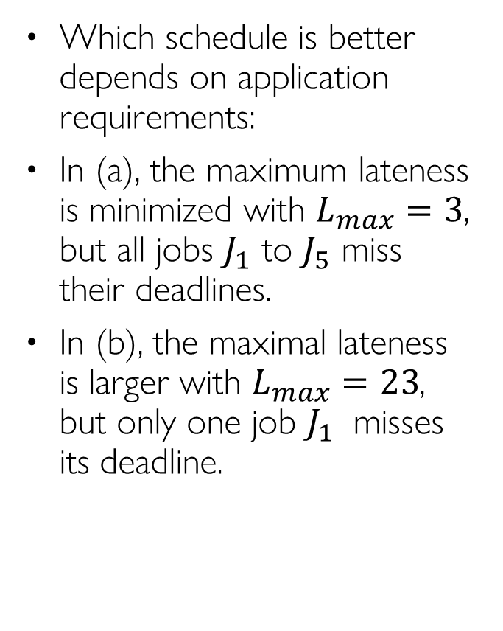
Example: Lateness
Which schedule is better depends on application requirements:
In (a), the maximum lateness is minimized with $L_{max}=3$, but all jobs $J_{1}$ to $J_{5}$ miss their deadlines.
In (b), the maximal lateness is larger with $L_{max}=23$, but only one job $J_{1}$ misses its deadline.

Slide 26
Scheduling Algorithms
Static cyclic scheduling (offline)
All task invocation times are computed offline and stored in a table; Runtime dispatch is a simple table lookup
Online scheduling;
Fixed priority scheduling (also called static-priority scheduling)
Each task is assigned a fixed priority; Runtime dispatch is priority-based, e.g., Rate Monotonic (RM), Deadline Monotonic (DM)
Dynamic priority scheduling
Task priorities are assigned dynamically at runtime, e.g., Earliest Deadline First (EDF), Least-Laxity First (LLF)
Non-real-time scheduling, e.g., round-robin, multi-level queue…
RT scheduling algorithms
Static cyclic scheduling
(offline)
Online scheduling
Fixed-priority
(e.g., RM, DM)
Dynamic-priority
(e.g., EDF, LLF)

Slide 27
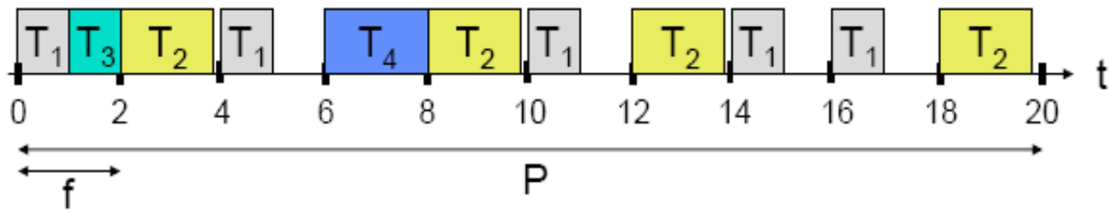
Static Cyclic Scheduling
The same schedule is executed once during each hyper-period (least common multiple of all task periods in a taskset).
The hyper-period is partitioned into frames of length f.
If a task’s WCET exceeds f, then programmer needs to cut it to fit within a frame, and save/restore program state manually
The schedule is computed offline and stored in a table. Runtime task dispatch is a simple table lookup.
Pros:
Deals with precedence, exclusion, and distance constraints
Efficient, low-overhead for runtime task dispatch
Lock-free at runtime
Cons:
Task table can get very large if task periods are relatively prime
Maintenance nightmare: complete redesign when new tasks are added, or old tasks are deleted
Not widely used
Except in certain safety-critical systems such as avionic systems
Notes:
Execution timeline is an infinite sequence of hyper periods
Online monitoring and exception handling (babbling idiot prevention)
Advantages:
Deals with precedence, exclusion, and distance constraints
Efficient, low-overhead for runtime task dispatch
Lock-free at runtime
Online monitoring and exception handling (babbling idiot prevention)
Disadvantages:
Not efficient for event-driven workload
Maintenance nightmare
Complete redesign when new tasks are added, or old tasks are deleted

Slide 28
Fixed-Priority Scheduling

Slide 29
Fixed Priority Scheduling
Each task is assigned a fixed priority for all its invocations
Pros:
Predictability
Low runtime overhead
Temporal isolation during overload
Cons:
Cannot achieve 100% utilization in general, except when task periods are harmonic
Widely used in most commercial RTOSes and CAN bus

Slide 30
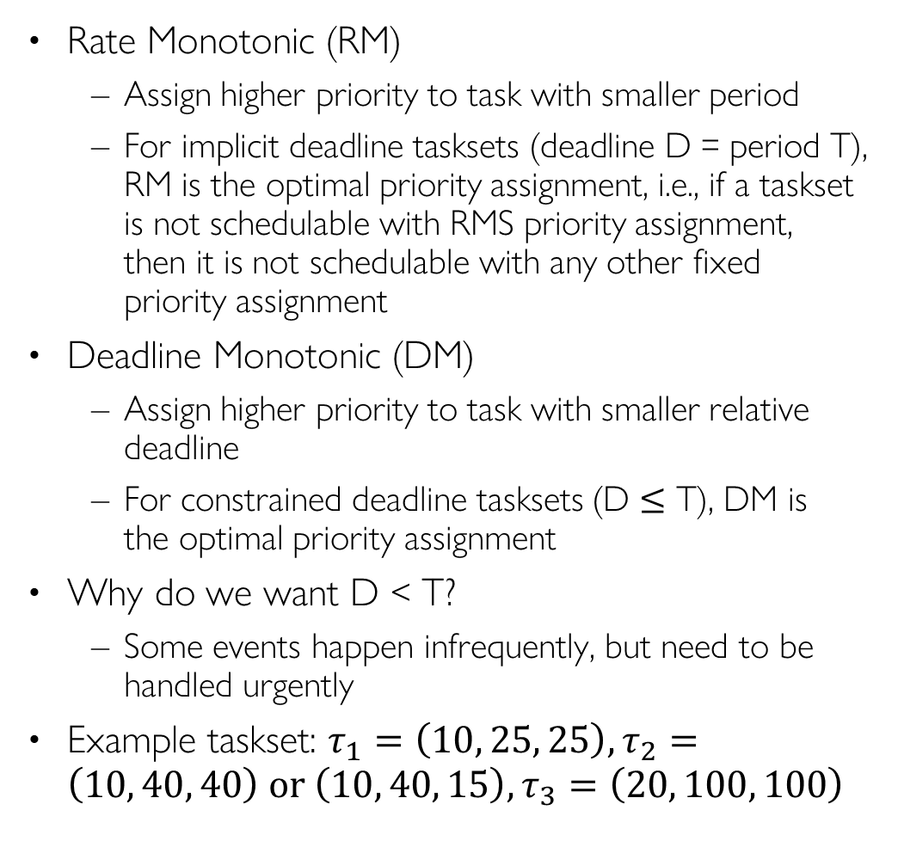
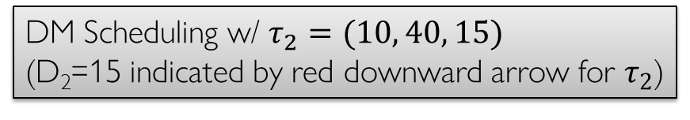
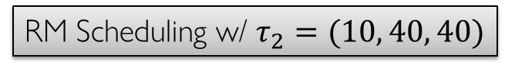
Rate Monotonic & Deadline Monotonic Scheduling
Rate Monotonic (RM)
Assign higher priority to task with smaller period
For implicit deadline tasksets (deadline D = period T), RM is the optimal priority assignment, i.e., if a taskset is not schedulable with RMS priority assignment, then it is not schedulable with any other fixed priority assignment
Deadline Monotonic (DM)
Assign higher priority to task with smaller relative deadline
For constrained deadline tasksets (D $≤$ T), DM is the optimal priority assignment
Why do we want D < T?
Some events happen infrequently, but need to be handled urgently
Example taskset: $τ_{1}=\left(10, 25, 25\right), τ_{2}=\left(10, 40, 40\right) or \left(10, 40, 15\right),τ_{3}=\left(20, 100, 100\right)$
τ1
0
25
50
75
100
τ2
0
40
80
τ3
0
100
RM Scheduling w/ $τ_{2}=(10, 40, 40)$
τ1
0
25
50
75
100
τ2
0
40
80
τ3
0
100
DM Scheduling w/ $τ_{2}=(10, 40, 15)$
(D₂=15 indicated by red downward arrow for $τ_{2}$)
Notes:
RTA also applies to DMS

Slide 31
Two Schedulability Analysis Approaches
IMPORTANT
Utilization bound test
Calculate total CPU utilization and compare it to a known bound
Polynomial time complexity
Pessimistic: sufficient but not necessary condition for schedulability
Response Time Analysis (RTA)
Calculate Worst-Case Response Time R_{i} for each task Tau_{i} and compare it to its deadline D_{i}
Pseudo-polynomial time complexity
An algorithm runs in pseudo-polynomial time if its running time is polynomial in the numeric value of the input (which is exponential in the length of the input – its number of digits).
Accurate: necessary and sufficient condition for schedulability
Notes:
refers to a class of algorithms whose running time is polynomial in the numeric value of the input but not necessarily in the input size (the number of bits required to represent the input). This distinction arises because the numeric value of an input can be exponentially larger than its representation in bits.

Slide 32



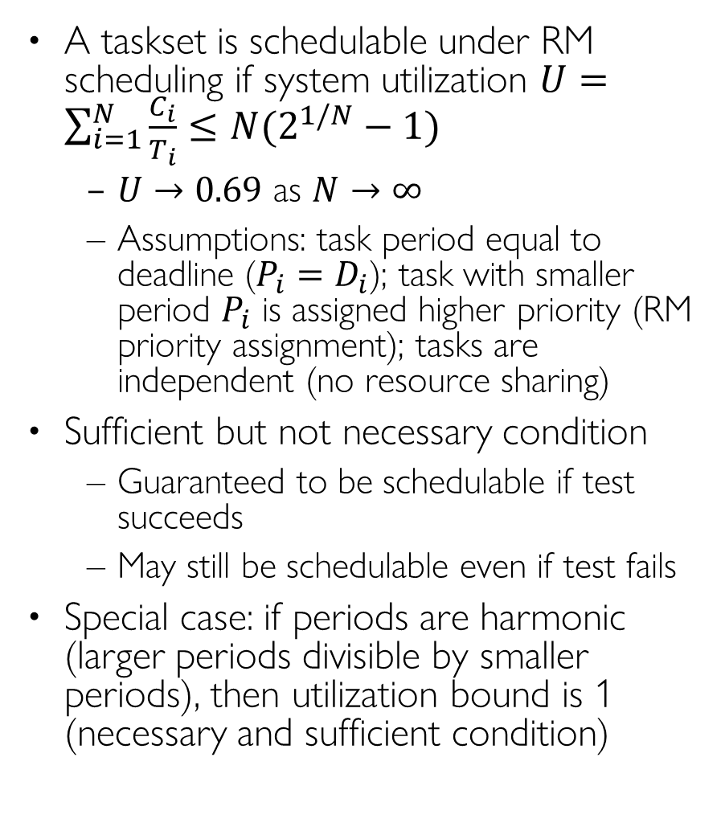
Utilization Bound Test
IMPORTANT
A taskset is schedulable under RM scheduling if system utilization $U=\sum_{i=1}^{N}{\frac{C_{i}}{T_{i}}}≤N(2^{1/N}−1)$
$U→0.69$ as $N→∞$
Assumptions: task period equal to deadline ($P_{i}=D_{i}$); task with smaller period $P_{i}$ is assigned higher priority (RM priority assignment); tasks are independent (no resource sharing)
Sufficient but not necessary condition
Guaranteed to be schedulable if test succeeds
May still be schedulable even if test fails
Special case: if periods are harmonic (larger periods divisible by smaller periods), then utilization bound is 1 (necessary and sufficient condition)
# Tasks | RM Util Bound
1 | 1.00
2 | 0.828
3 | 0.780
4 | 0.757
5 | 0.743
10 | 0.718
inf | 0.693
CPU%
100
90
80
70
60
50
40
30
20
10
0
RM UB Test
69%
# tasks
1 2 3 4 5 6 7 8 9 10
Notes:
(not deadline-monotonic!) Applies to rate-monotonic priority assignmentA taskset is schedulable under RM scheduling if its system utilization $U=\sum_{i=1}^{N}{\frac{C_{i}}{T_{i}}}≤N(2^{1/N}−1)$
$U→0.69$ as $N→∞$
Assumptions: task period equal to deadline ($P_{i}=D_{i}$); task with smaller period $P_{i}$ is assigned higher priority (RM priority assignment); tasks are independent (no resource sharing)

Slide 33
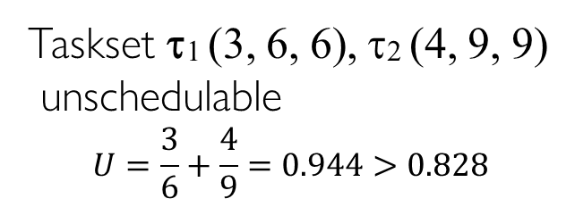
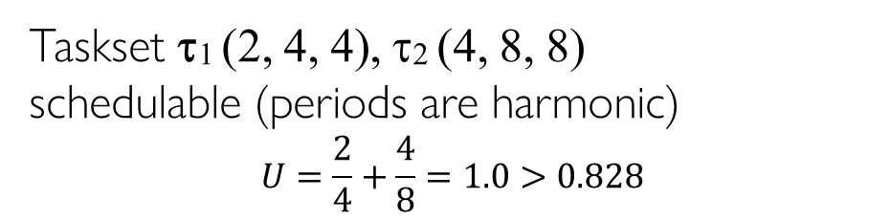
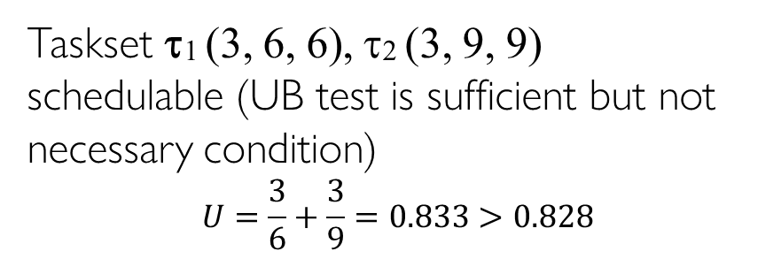
Utilization Bound Test Examples
We use the notation τi (Ci, Ti, Di) to denote task τi with WCET Ci Period Ti, Deadline Di
τ1
Taskset τ1 (3, 6, 6), τ2 (4, 9, 9)
unschedulable
$$U=\frac{3}{6}+\frac{4}{9}=0.944>0.828$$
0
3
6
9
12
15
18
τ2
0
3
6
9
12
15
18
deadline miss
Taskset τ1 (3, 6, 6), τ2 (3, 9, 9)
schedulable (UB test is sufficient but not necessary condition)
$$U=\frac{3}{6}+\frac{3}{9}=0.833>0.828$$
τ1
0
3
6
9
12
15
18
τ2
0
3
6
9
12
15
18
τ1
Taskset τ1 (2, 4, 4), τ2 (4, 8, 8)
schedulable (periods are harmonic)
$$U=\frac{2}{4}+\frac{4}{8}=1.0>0.828$$
0
4
8
12
16
τ2
0
4
8
12
16

Slide 34
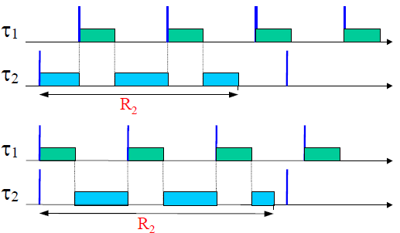
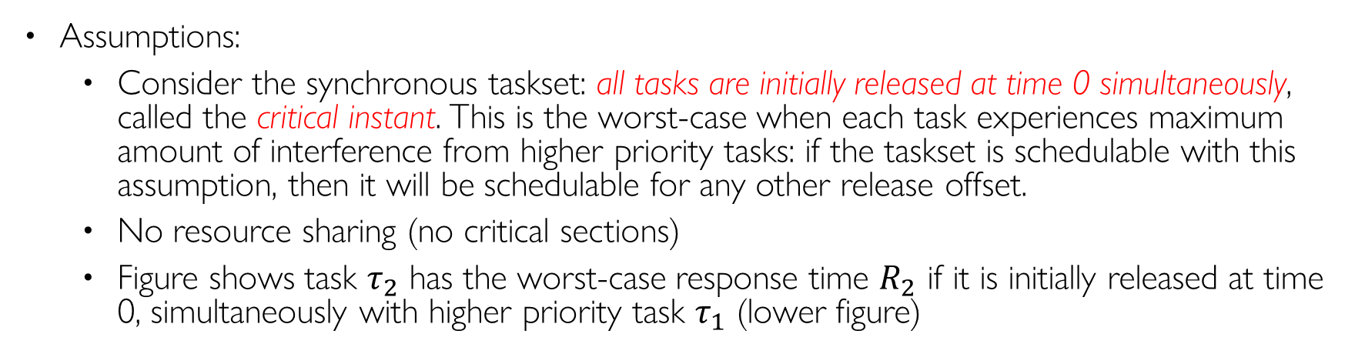
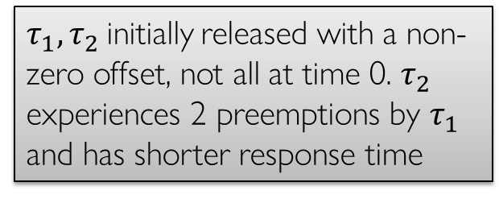
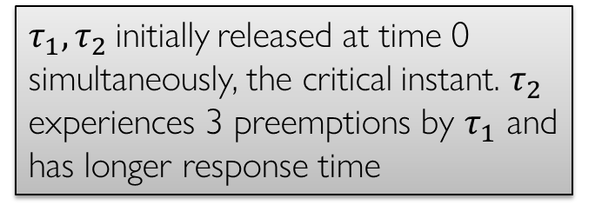
Response Time Analysis (RTA)
Assumptions:
Consider the synchronous taskset: all tasks are initially released at time 0 simultaneously, called the critical instant. This is the worst-case when each task experiences maximum amount of interference from higher priority tasks: if the taskset is schedulable with this assumption, then it will be schedulable for any other release offset.
No resource sharing (no critical sections)
Figure shows task $τ_{2}$ has the worst-case response time $R_{2}$ if it is initially released at time 0, simultaneously with higher priority task $τ_{1}$ (lower figure)
$τ_{1}, τ_{2}$ initially released with a non-zero offset, not all at time 0. $τ_{2}$ experiences 2 preemptions by $τ_{1}$ and has shorter response time
$τ_{1}, τ_{2}$ initially released at time 0 simultaneously, the critical instant. $τ_{2}$ experiences 3 preemptions by $τ_{1}$ and has longer response time
Notes:
Synchronous taskset: all tasks are released at time 0 simultaneously.
This is the worst-case: if taskset is schedulable with this assumption, then it will be schedulable for any other release offset
Let’s explain this equation with the example taskset

Slide 35
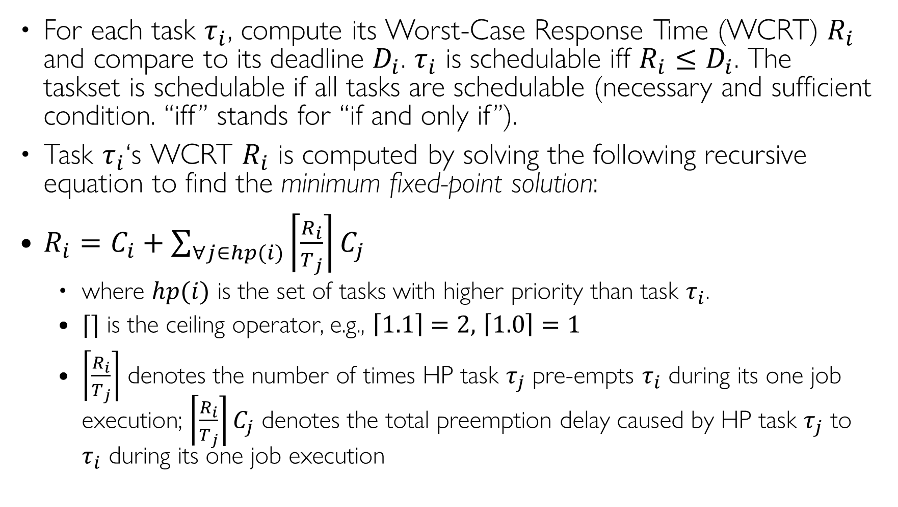
Response Time Analysis (RTA)
IMPORTANT
For each task $τ_{i}$, compute its Worst-Case Response Time (WCRT) $R_{i}$ and compare to its deadline $D_{i}$. $τ_{i}$ is schedulable iff ${R_{i}≤D}_{i}$. The taskset is schedulable if all tasks are schedulable (necessary and sufficient condition. “iff” stands for “if and only if”).
Task $τ_{i}$‘s WCRT $R_{i}$ is computed by solving the following recursive equation to find the minimum fixed-point solution:
$R_{i}=C_{i}+\sum_{∀j∈hp(i)}{\left\lceil \frac{R_{i}}{T_{j}}\right\rceil C_{j}}$
where $hp(i)$ is the set of tasks with higher priority than task $τ_{i}$.
$⌈⌉$ is the ceiling operator, e.g., $\left\lceil 1.1\right\rceil =2,$ $\left\lceil 1.0\right\rceil =1$
$\left\lceil \frac{R_{i}}{T_{j}}\right\rceil$ denotes the number of times HP task $τ_{j}$ pre-empts $τ_{i}$ during its one job execution; $\left\lceil \frac{R_{i}}{T_{j}}\right\rceil C_{j}$ denotes the total preemption delay caused by HP task $τ_{j}$ to $τ_{i}$ during its one job execution
Notes:
Synchronous taskset: all tasks are released at time 0 simultaneously.
This is the worst-case: if taskset is schedulable with this assumption, then it will be schedulable for any other release offset
Let’s explain this equation with the example taskset

Slide 36
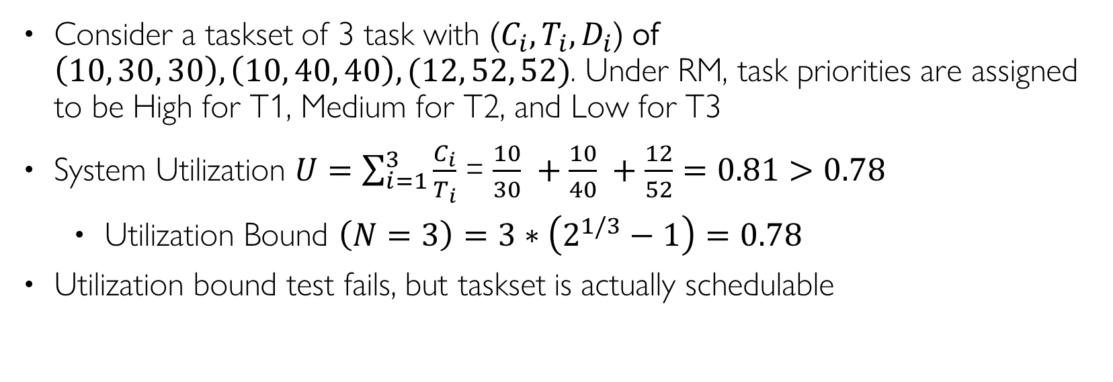
An Example Taskset
Consider a taskset of 3 task with ($C_{i}, T_{i}{, D}_{i}$) of $\left(10, 30, 30\right),\left(10, 40, 40\right),(12, 52, 52)$. Under RM, task priorities are assigned to be High for T1, Medium for T2, and Low for T3
System Utilization $U=\sum_{i=1}^{3}{\frac{C_{i}}{T_{i}}}$ = $\frac{10}{30} +\frac{10}{40} +\frac{12}{52}=0.81>0.78$
Utilization Bound $\left(N=3\right)=3∗\left(2^{1/3}−1\right)=0.78$
Utilization bound test fails, but taskset is actually schedulable
Task | T=D | C | Prio
T1 | 30 | 10 | H
T2 | 40 | 10 | M
T3 | 52 | 12 | L

Slide 37

Task T1
Task | T=D | C | Prio
T1 | 30 | 10 | H
T2 | 40 | 10 | M
T3 | 52 | 12 | L
T1 is the highest priority task, with no interference from other tasks $hp\left(1\right)=∅$
$R_{1}=C_{1}+0=10$
$R_{1}<D_{1}$, so T1 is schedulable
Task
T1
T1
0
10
20
30
40
50
Time

Slide 38
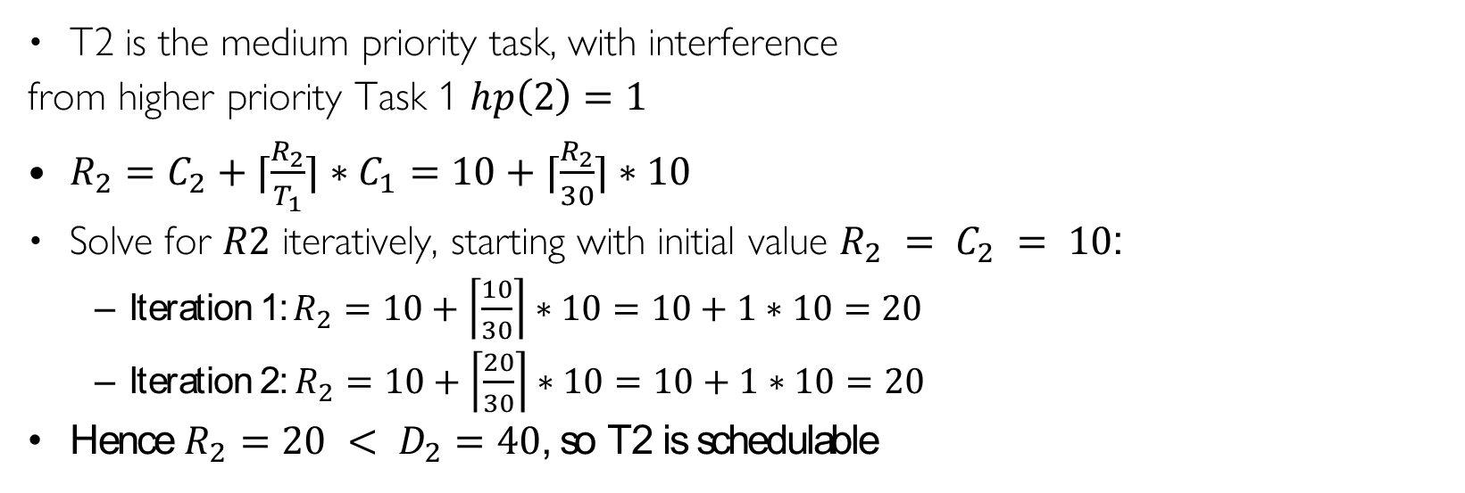
Task T2
Task | T=D | C | Prio
T1 | 30 | 10 | H
T2 | 40 | 10 | M
T3 | 52 | 12 | L
T2 is the medium priority task, with interference
from higher priority Task 1 $hp\left(2\right)=1$
$R_{2}=C_{2}+⌈\frac{R_{2}}{T_{1}}⌉∗C_{1}=10+⌈\frac{R_{2}}{30}⌉∗10$
Solve for $R2$ iteratively, starting with initial value $R_{2} = C_{2} = 10$:
Iteration 1: $R_{2}=10+\left\lceil \frac{10}{30}\right\rceil ∗10=10+1∗10=20$
Iteration 2: $R_{2}=10+\left\lceil \frac{20}{30}\right\rceil ∗10=10+1∗10=20$
Hence $R_{2}=20 < D_{2}=40$, so T2 is schedulable
Task
T1
T1
T2
T2
0
10
20
30
40
50
Time

Slide 39
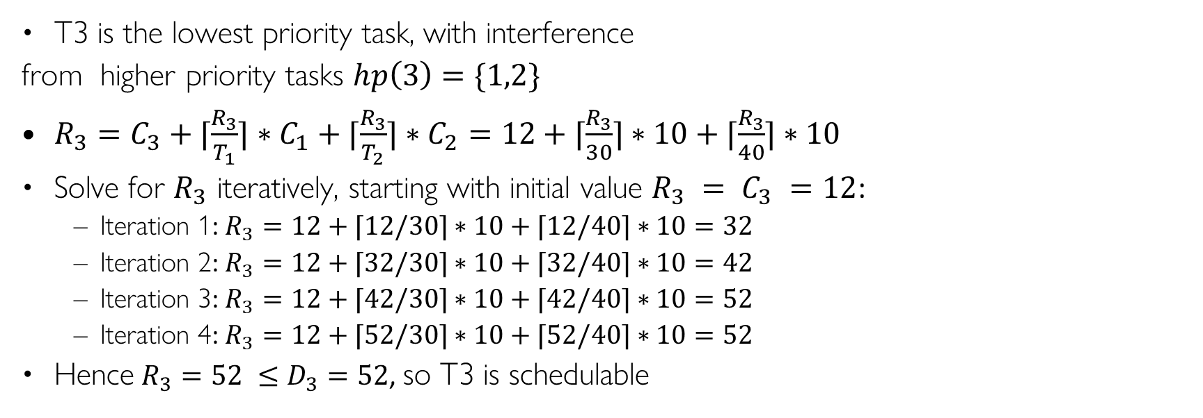
Task T3
Task | T=D | C | Prio
T1 | 30 | 10 | H
T2 | 40 | 10 | M
T3 | 52 | 12 | L
T3 is the lowest priority task, with interference
from higher priority tasks $hp\left(3\right)=\{1,2\}$
$R_{3}=C_{3}+⌈\frac{R_{3}}{T_{1}}⌉∗C_{1}+⌈\frac{R_{3}}{T_{2}}⌉∗C_{2}=12+⌈\frac{R_{3}}{30}⌉∗10+⌈\frac{R_{3}}{40}⌉∗10$
Solve for $R_{3}$ iteratively, starting with initial value $R_{3} = C_{3} =12$:
Iteration 1: $R_{3}=12+⌈12/30⌉∗10+⌈12/40⌉∗10=32$
Iteration 2: $R_{3}=12+⌈32/30⌉∗10+⌈32/40⌉∗10=42$
Iteration 3: $R_{3}=12+⌈42/30⌉∗10+⌈42/40⌉∗10=52$
Iteration 4: $R_{3}=12+⌈52/30⌉∗10+⌈52/40⌉∗10=52$
Hence $R_{3}=52 ≤D_{3}=52$, so T3 is schedulable
0
Task
T1
T1
T2
T2
T3
T3
0
10
20
30
40
50
Time

Slide 40

RTA for T3: Initial Condition
Task | T=D | C | Prio
T1 | 30 | 10 | H
T2 | 40 | 10 | M
T3 | 52 | 12 | L
T2
Initially $R_{3} = 12$
We have not taken into account any preemption delays from higher priority tasks T1 and T2 yet
Task
T1
T1
T2
T2
T3
0
10
12
20
30
40
50
Time

Slide 41
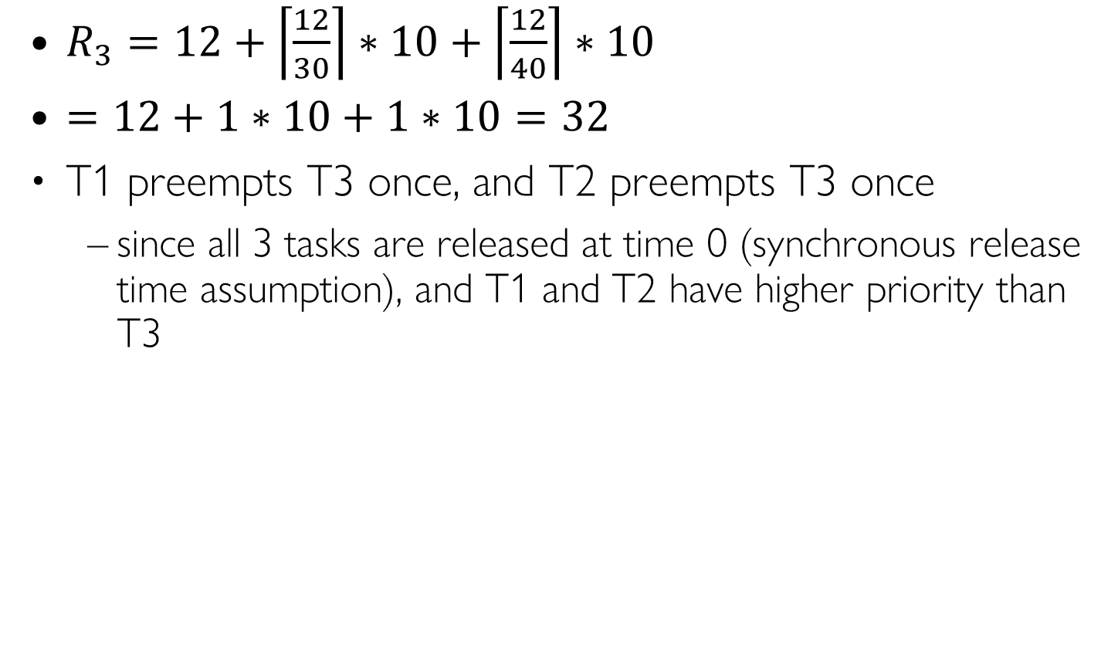
RTA for Task 3: Iteration 1
Task | T=D | C | Prio
T1 | 30 | 10 | H
T2 | 40 | 10 | M
T3 | 52 | 12 | L
$R_{3}=12+\left\lceil \frac{12}{30}\right\rceil ∗10+\left\lceil \frac{12}{40}\right\rceil ∗10$
$=12+1∗10+1∗10=32$
T1 preempts T3 once, and T2 preempts T3 once
since all 3 tasks are released at time 0 (synchronous release time assumption), and T1 and T2 have higher priority than T3
Task
T1
T1
T2
T2
T3
0
10
20
30
32
40
50
Time

Slide 42
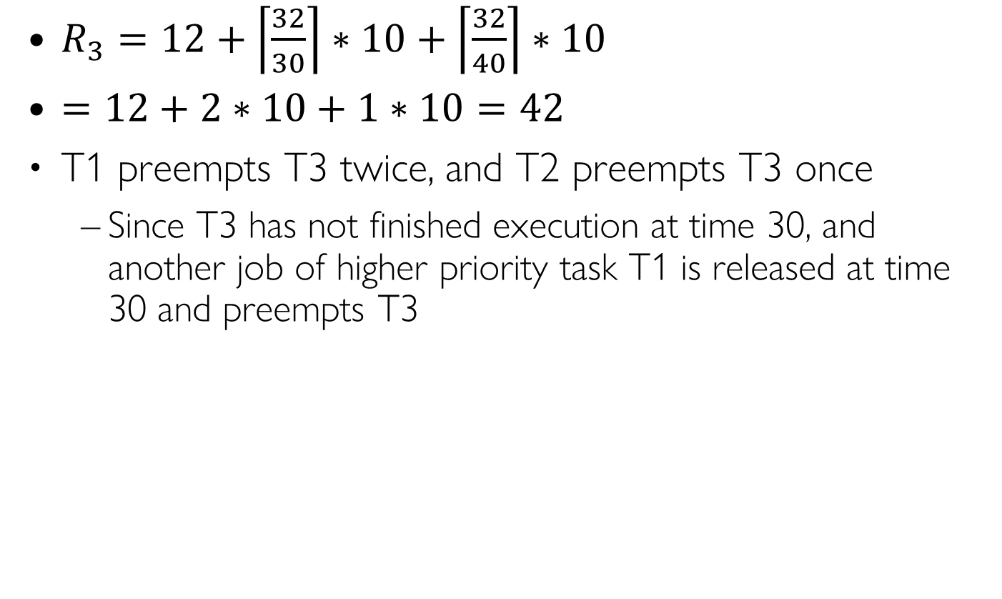
RTA for Task 3: Iteration 2
Task | T=D | C | Prio
T1 | 30 | 10 | H
T2 | 40 | 10 | M
T3 | 52 | 12 | L
$R_{3}=12+\left\lceil \frac{32}{30}\right\rceil ∗10+\left\lceil \frac{32}{40}\right\rceil ∗10$
$=12+2∗10+1∗10=42$
T1 preempts T3 twice, and T2 preempts T3 once
Since T3 has not finished execution at time 30, and another job of higher priority task T1 is released at time 30 and preempts T3
Task
T1
T1
T2
T2
T3
T3
0
10
20
30
40
42
50
Time
Notes:
R3 = 12 + ceil(32/30)*10 + ceil(32/40)*10 = 42

Slide 43
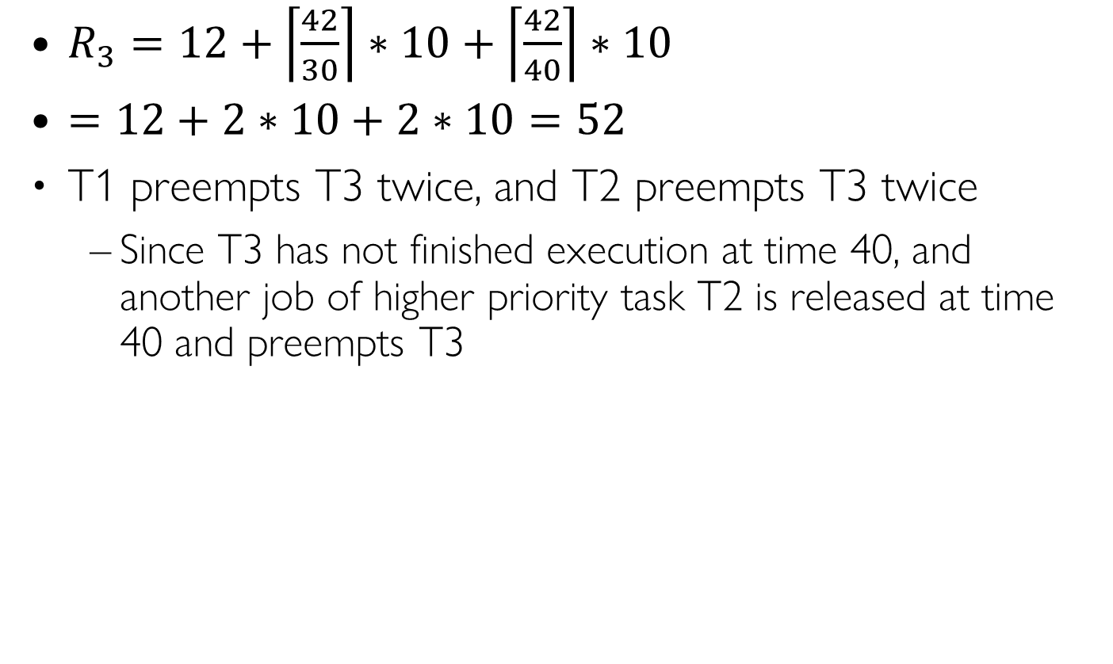
RTA for Task 3: Iteration 3
Task | T=D | C | Prio
T1 | 30 | 10 | H
T2 | 40 | 10 | M
T3 | 52 | 12 | L
$R_{3}=12+\left\lceil \frac{42}{30}\right\rceil ∗10+\left\lceil \frac{42}{40}\right\rceil ∗10$
$=12+2∗10+2∗10=52$
T1 preempts T3 twice, and T2 preempts T3 twice
Since T3 has not finished execution at time 40, and another job of higher priority task T2 is released at time 40 and preempts T3
Task
T1
T1
T2
T2
T3
T3
0
10
20
30
40
50
52
Time

Slide 44
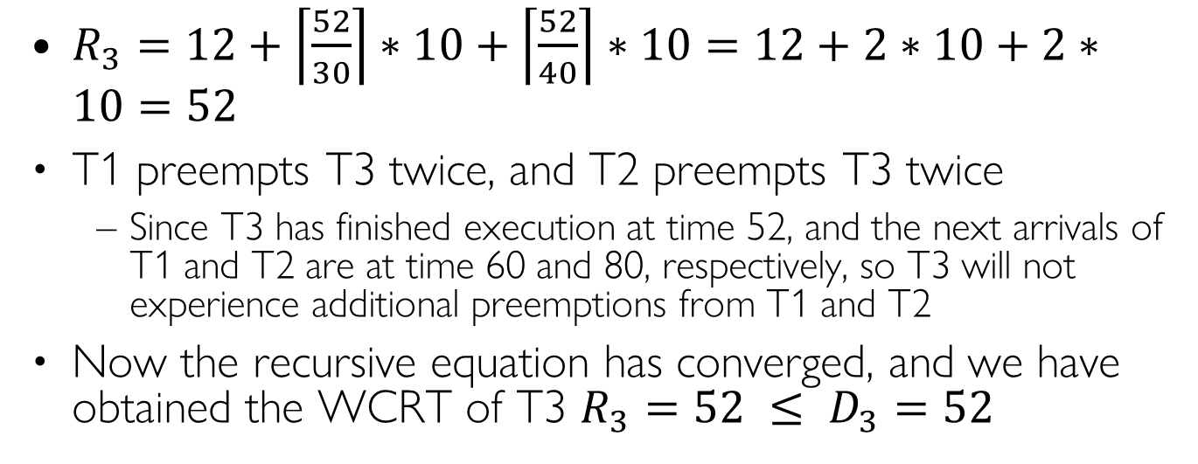
RTA for Task 3: Iteration 4
Task | T=D | C | Prio
T1 | 30 | 10 | H
T2 | 40 | 10 | M
T3 | 52 | 12 | L
$R_{3}=12+\left\lceil \frac{52}{30}\right\rceil ∗10+\left\lceil \frac{52}{40}\right\rceil ∗10=12+2∗10+2∗10=52$
T1 preempts T3 twice, and T2 preempts T3 twice
Since T3 has finished execution at time 52, and the next arrivals of T1 and T2 are at time 60 and 80, respectively, so T3 will not experience additional preemptions from T1 and T2
Now the recursive equation has converged, and we have obtained the WCRT of T3 $R_{3}=52 ≤ D_{3}=52$
Task
T1
T1
T2
T2
T3
T3
0
10
20
30
40
50
52
Time
Notes:
$$R_{3} = 52 ≤D_{3} = 52$$

Slide 45
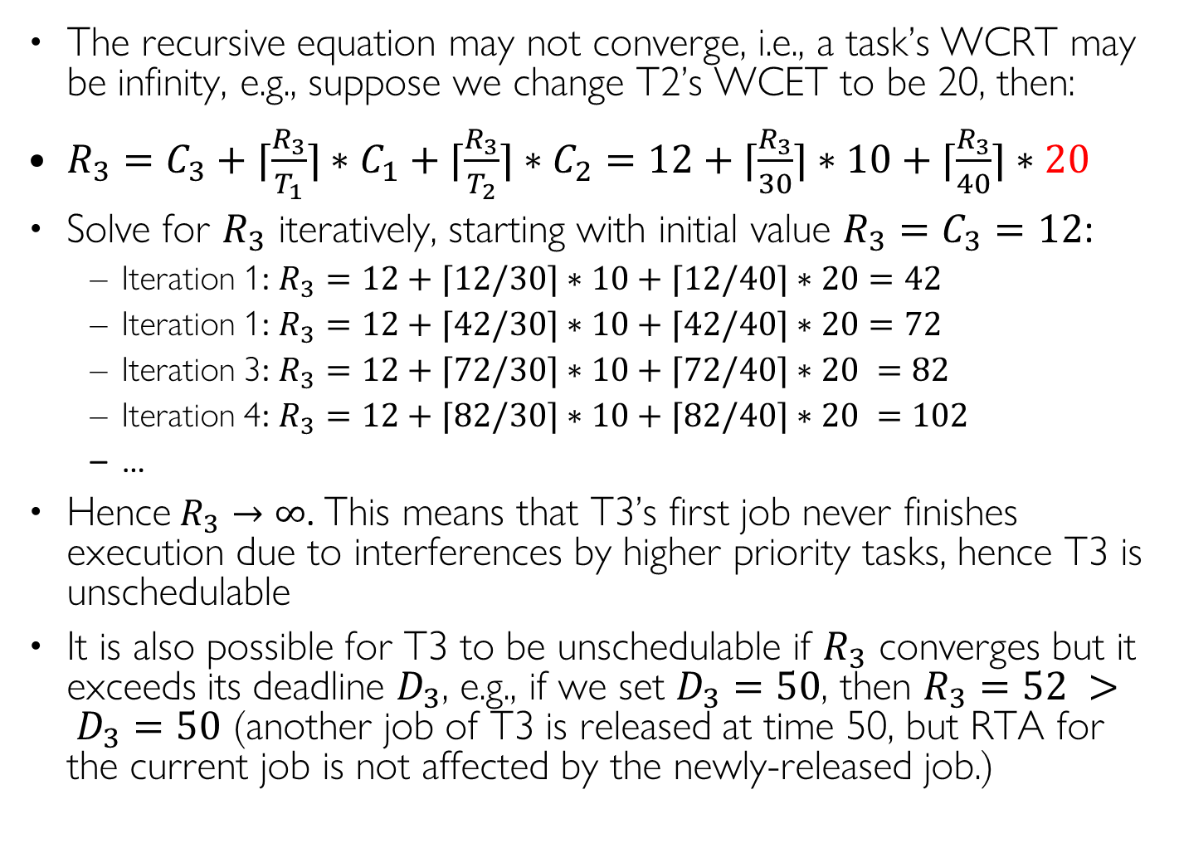
When T3 is Unschedulable
The recursive equation may not converge, i.e., a task’s WCRT may be infinity, e.g., suppose we change T2’s WCET to be 20, then:
$R_{3}=C_{3}+⌈\frac{R_{3}}{T_{1}}⌉∗C_{1}+⌈\frac{R_{3}}{T_{2}}⌉∗C_{2}=12+⌈\frac{R_{3}}{30}⌉∗10+⌈\frac{R_{3}}{40}⌉∗20$
Solve for $R_{3}$ iteratively, starting with initial value $R_{3}=C_{3}=12$:
Iteration 1: $R_{3}=12+⌈12/30⌉∗10+⌈12/40⌉∗20=42$
Iteration 1: $R_{3}=12+⌈42/30⌉∗10+⌈42/40⌉∗20=72$
Iteration 3: $R_{3}=12+⌈72/30⌉∗10+⌈72/40⌉∗20 =82$
Iteration 4: $R_{3}=12+⌈82/30⌉∗10+⌈82/40⌉∗20 =102$
…
Hence $R_{3}→∞$. This means that T3’s first job never finishes execution due to interferences by higher priority tasks, hence T3 is unschedulable
It is also possible for T3 to be unschedulable if $R_{3}$ converges but it exceeds its deadline $D_{3}$, e.g., if we set $D_{3}=50$, then $R_{3}=52 > D_{3}=50$ (another job of T3 is released at time 50, but RTA for the current job is not affected by the newly-released job.)
Task | T=D | C | Prio
T1 | 30 | 10 | H
T2 | 40 | 20 | M
T3 | 52 | 12 | L
0
Task | T=D | C | Prio
T1 | 30 | 10 | H
T2 | 40 | 10 | M
T3 | 50 | 12 | L

Slide 46
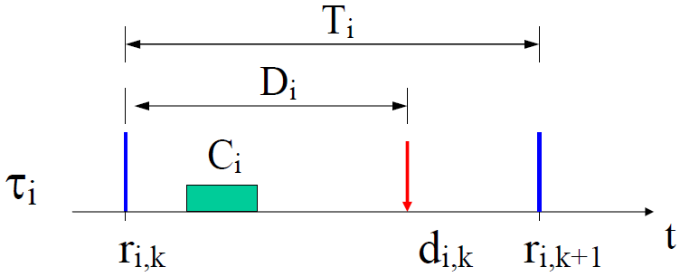
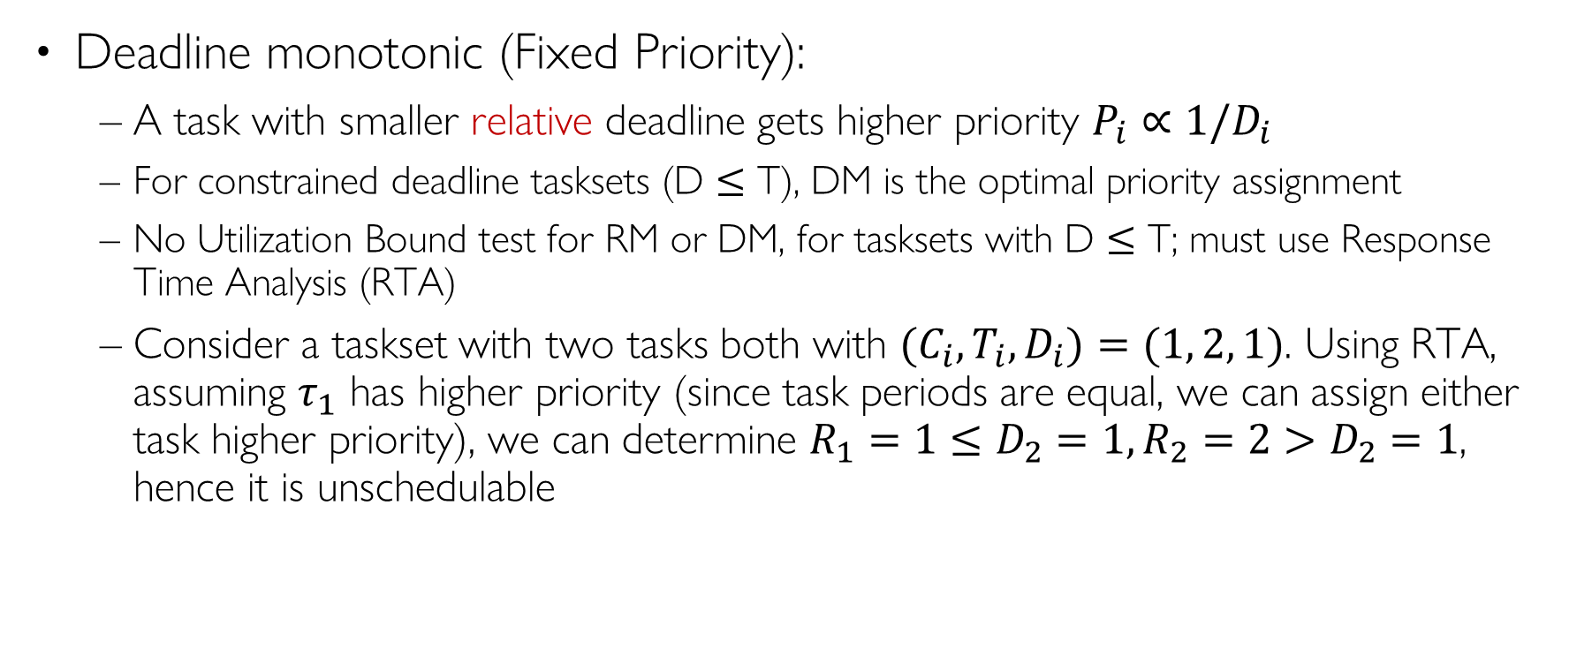
DM for Constrained Deadline Tasksets (D $≤$ T)
Deadline monotonic (Fixed Priority):
A task with smaller relative deadline gets higher priority $P_{i}∝1/D_{i}$
For constrained deadline tasksets (D $≤$ T), DM is the optimal priority assignment
No Utilization Bound test for RM or DM, for tasksets with D $≤$ T; must use Response Time Analysis (RTA)
Consider a taskset with two tasks both with ${(C}_{i},T_{i}, D_{i})=(1, 2, 1)$. Using RTA, assuming $τ_{1}$ has higher priority (since task periods are equal, we can assign either task higher priority), we can determine $R_{1}=1≤D_{2}=1, R_{2}=2>D_{2}=1$, hence it is unschedulable
Notes:
Schedulability analysis need to be changed (discussions omitted) but we can not use it to determine schedulability
Overhead: EDF typically exhibits less frequent preemptions ⇒ lower overhead
Overrun behavior (U > 1): EDF – automatic “period rescaling”, RM – complete blocking of lower priority tasks Transient: Task overrun can cause deadline miss of EDF: arbitrary task RM: only lower priority task If we don’t know which task will overrun, the result is the same. Jitter and latency: RM has no jitter only for the highest-priority task. In overall comparison, EDF provides better results (smaller release-time jitter a smaller input-output latency) Resource reservation: Simpler in case of EDF (see future lecture)

Slide 47
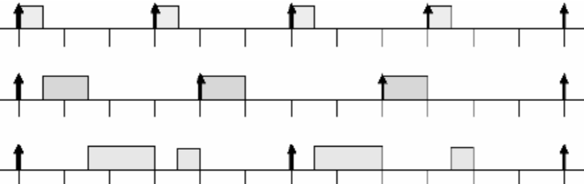
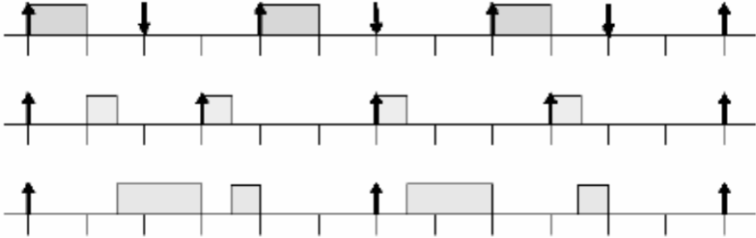


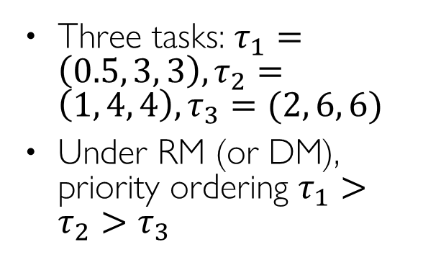


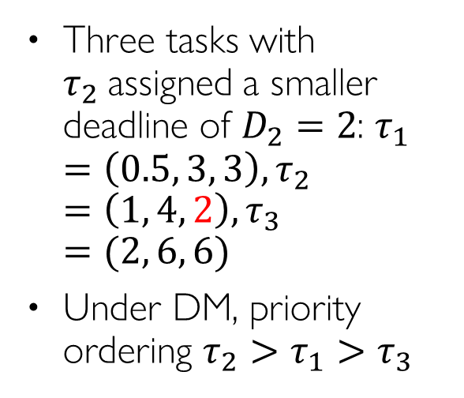


RM vs. DM Example
Three tasks: $τ_{1}=\left(0.5, 3, 3\right), τ_{2}=\left(1, 4, 4\right), τ_{3}=(2, 6, 6)$
Under RM (or DM), priority ordering $τ_{1}>τ_{2}>τ_{3}$
$$τ_{1}$$
$$τ_{2}$$
$$τ_{3}$$
0
3
6
9
12
Three tasks with $τ_{2}$assigned a smaller deadline of $D_{2}=2$: $τ_{1}=\left(0.5, 3, 3\right), τ_{2}=\left(1, 4, 2\right), τ_{3}=(2, 6, 6)$
Under DM, priority ordering $τ_{2}>τ_{1}>τ_{3}$
$$τ_{2}$$
$$τ_{1}$$
$$τ_{3}$$
0
3
6
9
12

Slide 48
Earliest Deadline First (EDF) Scheduling

Slide 49
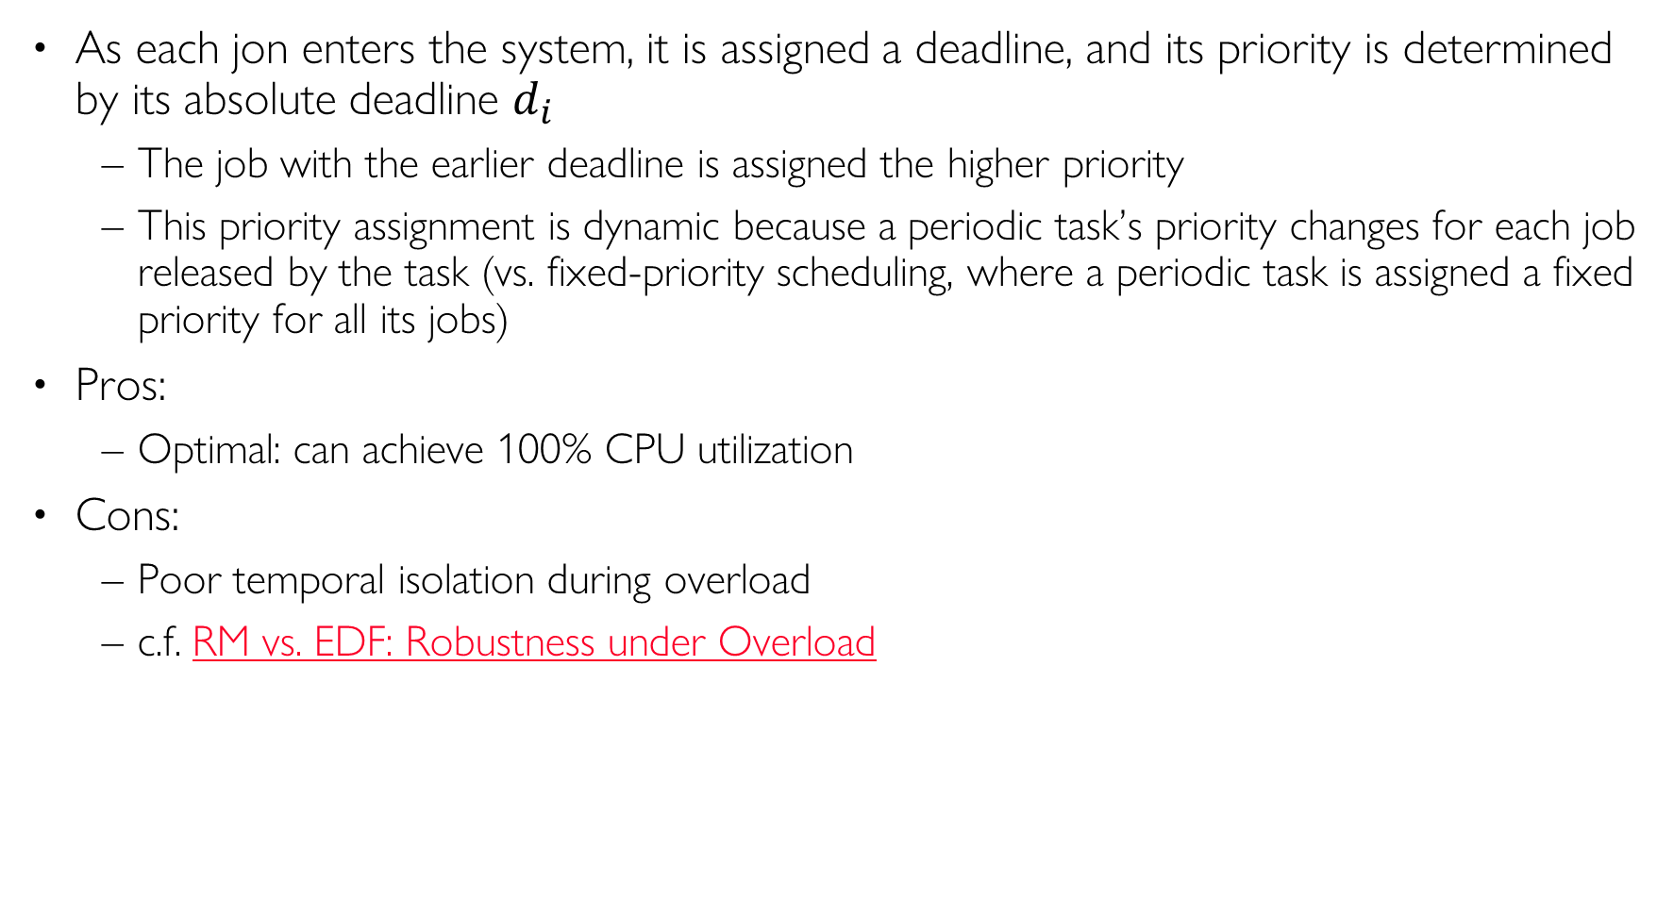
Earliest Deadline First (EDF)
As each jon enters the system, it is assigned a deadline, and its priority is determined by its absolute deadline $d_{i}$
The job with the earlier deadline is assigned the higher priority
This priority assignment is dynamic because a periodic task’s priority changes for each job released by the task (vs. fixed-priority scheduling, where a periodic task is assigned a fixed priority for all its jobs)
Pros:
Optimal: can achieve 100% CPU utilization
Cons:
Poor temporal isolation during overload
c.f. RM vs. EDF: Robustness under Overload
Notes:
EDF minimizes lateness of the “most tardy task” [Dertouzos, 1974] High runtime overhead for managing ready
Earliest Deadline First (EDF)
Each job is assigned a deadline upon its arrival
Task with earlier deadline is assigned higher priority
Pros: can achieve 100% utilization
Cons: high runtime overhead, lack of temporal protection for HP tasks

Slide 50
EDF Scheduling Example
Say you have two tasks, both released at time 0
T1 has WCET 5 ms, with deadline of 20 ms
T2 has WCET 10 ms, with deadline of 12 ms
Non-EDF scheduling: T1 before T2, T2 misses its deadline at 12
EDF scheduling: T2 before T1, both tasks meet their deadlines
T2 Deadline
T1 Deadline
T1 before T2
T1
T2
0
5
15
20
T2 before T1
T2
T1
0
5
15
20
Convention: Upwards arrows indicate arrival time; Downwards arrows indicate deadline
Notes:
This is a simple example of EDF. Since it’s not widely used in the auto industry, we will not consider it further.

Slide 51

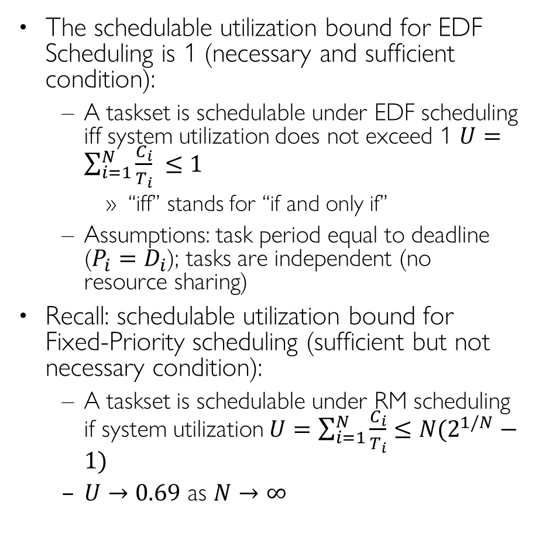
Schedulable Utilization Bound: EDF vs. RM
IMPORTANT
The schedulable utilization bound for EDF Scheduling is 1 (necessary and sufficient condition):
A taskset is schedulable under EDF scheduling iff system utilization does not exceed 1 $U=\sum_{i=1}^{N}{\frac{C_{i}}{T_{i}}} ≤1$
“iff” stands for “if and only if”
Assumptions: task period equal to deadline ($P_{i}=D_{i}$); tasks are independent (no resource sharing)
Recall: schedulable utilization bound for Fixed-Priority scheduling (sufficient but not necessary condition):
A taskset is schedulable under RM scheduling if system utilization $U=\sum_{i=1}^{N}{\frac{C_{i}}{T_{i}}}≤N(2^{1/N}−1)$
$U→0.69$ as $N→∞$
RM
EDF
CPU%
100
90
80
70
60
50
40
30
20
10
0
100%
69%
# tasks
1 2 3 4 5 6 7 8 9 10

Slide 52
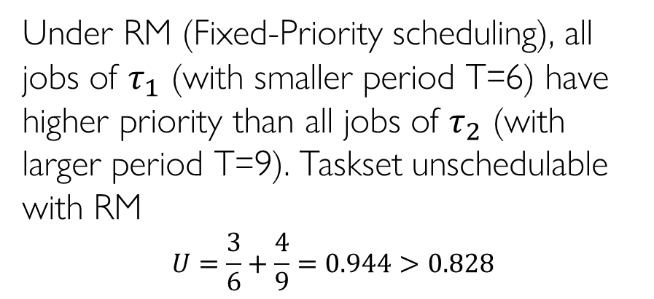
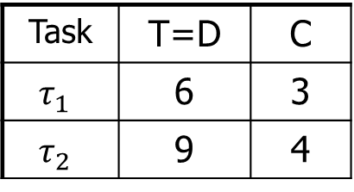

RM vs. EDF Example
Task | T=D | C
$$τ_{1}$$ | 6 | 3
$$τ_{2}$$ | 9 | 4
Under RM (Fixed-Priority scheduling), all jobs of $τ_{1}$ (with smaller period T=6) have higher priority than all jobs of $τ_{2}$ (with larger period T=9). Taskset unschedulable with RM
$$U=\frac{3}{6}+\frac{4}{9}=0.944>0.828$$
τ1
0
3
6
9
12
15
18
>
>
>
priority
τ2
0
3
6
9
12
15
18
deadline miss
Under EDF (Dynamic Priority scheduling), different jobs of $τ_{1}$ and $τ_{2}$ may have different priorities, depending on their absolute deadlines $d_{i}$, which is different for each newly-released job every period. Taskset schedulable with EDF
$$U=\frac{3}{6}+\frac{4}{9}=0.944<1.0$$
τ1
0
3
6
>
9
12
15
18
>
>
=
priority
τ2
0
3
6
9
12
15
18
When two jobs have equal priority, the newly arrived job does not preempt the running job
Notes:
L6-Exercises ANS.pptx p7 illustrates that, EDF uses absolute deadline di, which is different for each job, where DM/RM uses relative deadline Di, which is a static param that never changes, for setting priority of each job

Slide 53
RM vs. EDF: Robustness under Overload
Under permanent overload, with CPU utilization U > 1
Under EDF, all tasks execute at a slower rate with “period rescaling”, i. e., all tasks are delayed evenly
Under RM, higher priority tasks are protected while lower priority tasks are delayed or complete blocked
Recall Slide 25 Example Lateless
Under transient overload, when some job overruns (executes longer than expected temporarily)
Under EDF, task overruns can cause deadline miss of arbitrary task
Under RM: task overruns only affect lower priority tasks
Conclusion: RM offers better temporal isolation for higher priority tasks, at the expense of lower priority tasks
Notes:
Not transient overload
This occurs

Slide 54


EDF Period Rescaling
Theorem on Period Rescaling [Cervin et al. 2003]:
If system utilization $U > 1$, tasks are executed with an average period $T_{i}^{′}=T_{i}U$ under EDF scheduling

Slide 55


EDF for Constrained Deadline Tasksets (D $≤$ T)
IMPORTANT
Earliest Deadline First (Dynamic-Priority):
A task with smaller absolute deadline gets higher priority $P_{i}∝1/d_{i}$
EDF is still optimal, but instead of Utilization Bound, we use Density Bound to determine schedulability
Density of task $τ_{i}$ is defined as $δ_{i}=\frac{C_{i}}{min(D_{i},T_{i}) }$. Taskset is schedulable if system density does not exceed 1: $∆ =\sum_{i}{δ_{i}}≤1$ (sufficient but not necessary condition)
(Demand Bound Function can be used as necessary and sufficient condition (not covered))
Consider a taskset with two tasks both with ${(C}_{i},T_{i}, D_{i})=(1, 2, 1)$. It is obviously unschedulable under any scheduling algo. System utilization is $U=\frac{1}{2}+\frac{1}{2}=1$; System density $Δ=\frac{1}{1}+\frac{1}{1}=2$. But we cannot determine schedulabiity based on $Δ >1$.
Consider a taskset with two tasks $τ_{1}=\left(0.6, 2, 1\right), τ_{2}=(2.3, 5, 5)$. $∆ =\frac{0.6}{1}+\frac{2.3}{5}= 1.06$. Yet the taskset is schedulable under EDF:

Slide 56

Summary of Schedulability Analysis Algorithms
IMPORTANT
 | Fixed-Priority Scheduling |  | Dynamic Priority Scheduling
Optimal Scheduling Algorithm | Rate Monotonic (RM) Scheduling for implicit deadline taskset (D=T) | Deadline Monotonic (DM) Scheduling for constrained deadline taskset (D$≤$T) | Earliest Deadline First (EDF) Scheduling for implicit deadline taskset (D=T) | Earliest Deadline First (EDF) Scheduling for constrained deadline taskset (D$≤$T)
Schedulability Analysis Algorithm | Utilization Bound (UB) test $U=\sum_{i=1}^{N}{\frac{C_{i}}{T_{i}}}≤N(2^{1/N}−1)$ (sufficient condition) or Response Time Analysis (RTA) (necessary and sufficient) $$R_{i}=C_{i}+\sum_{∀j∈hp(i)}{\left\lceil \frac{R_{i}}{T_{j}}\right\rceil C_{j}}≤D_{i}$$ | RTA Response Time Analysis (RTA) (necessary and sufficient) $$R_{i}=C_{i}+\sum_{∀j∈hp(i)}{\left\lceil \frac{R_{i}}{T_{j}}\right\rceil C_{j}}≤D_{i}$$ | Utilization Bound (UB) test $U=\sum_{i=1}^{N}{\frac{C_{i}}{T_{i}}}≤1$ (necessary and sufficient) | Density Bound test $∆ =\sum_{i}{\frac{C_{i}}{min(D_{i},T_{i}) }}≤1$ (sufficient condition) or Demand Bound Function (not covered)

Slide 57
Least Laxity First (LLF) Scheduling

Slide 58





Least Laxity First (LLF) Scheduling
LLF assigns priority to jobs dynamically based on their current laxity (slack)
With absolute deadline $d_{i}$ and remaining execution time $e_{i}$, laxity of $τ_{i}$’s job at time $t$ is $l_{i}= d_{i} – t – e_{i}$. Job with the smallest laxity has the highest priority
While an active job waits and does not run, its laxity decreases and its priority increases until it becomes the highest priority job and starts to run
If an active job runs in the previous time slot, then its laxity remains the same, as $t$ is incremented by 1, and $e_{i}$ is decremented by 1
If an active job does not run in the previous time slot, then its laxity is decremented by 1, as $t$ is incremented by 1, and $e_{i}$ remains the same
Analogy: suppose you have an assignment that is due in 5 hours at 12:00, and it takes $e_{i}$=3 hours to complete. Current time is $t$=7:00, so the current laxity is $l_{i}=d_{i} – t – e_{i}$=12−7−3=2.
If you work for an hour until $t$=8:00, then the laxity remains the same: $l_{i}=d_{i} – t – e_{i}$=12−8−2=2, since the remaining execution time is decremented by 1: $e_{i}$=3-1=2
If you sleep for an hour until $t$=8:00, then the laxity is decremented by 1: $l_{i}=d_{i} – t – e_{i}$=12−8−3=1, since the remaining execution time does not change: $e_{i}$=3
If you sleep for 2 hours until $t$=9:00, then the laxity is now 0: $l_{i}=d_{i} – t – e_{i}$=12−9−3=0. Your must give the assignment the highest priority and start working on it right away, otherwise you will miss the deadline
EDF and LLF are both optimal scheduling algorithms, i.e., they both have schedulable utilization bound of 1
LLF incurs frequent context switches, hence is less practical than EDF
$$l_{i}$$
$$e_{i}$$
t
$d_{i}$

Slide 59

RM, EDF, LLF Example
Task | T=D | C
T1 | 5 | 2
T2 | 6 | 3
Task
T1
T1
T1
T2
T2
0 | 1 | 2 | 3 | 4 | 5 | 6 | 7 | 8 | 9 | 10 | 11 | 12
Time
Time | τ₁ Laxity | τ₂ Laxity | Running Task
t=0 | 5-0-2=3 | 6-0-3=3 | $τ₁$ (tie)
t=1 | 5-1-1=3 | 6-1-3=2 | $$τ₂$$
t=2 | 5-2-1=2 | 6-2-2=2 | $τ₂$(tie)
t=3 | 5-3-1=1 | 6-3-1=2 | $$τ₁$$
t=4 | $τ₁$ done | 6-4-1=1 | $$τ₂$$
t=5 | 10-5-2=3 | $τ₂$ done | $$τ₁$$
t=6 | 10-6-1=3 | 12-6-3=3 | $τ₁$ (tie)
t=7 | $τ₁$ done | 12-7-3=2 | $$τ₂$$
EDF and RM have the same schedule
Task
T1
T1
T1
T1
T2
T2
T2
0 | 1 | 2 | 3 | 4 | 5 | 6 | 7 | 8 | 9 | 10 | 11 | 12
Time
LLF has more frequent context switches

Slide 60
Preemptive vs. Non-Preemptive Scheduling

Slide 61

Preemptive vs. Non-Preemptive Scheduling
Non-preemptive scheduling pros:
It reduces runtime overhead
Less context switches
No mutex locks needed for critical sections
It preserves program locality, improving the effectiveness of CPU cache
As a result, task WCET becomes smaller and execution time distribution becomes more predictable (shown on right)
Sometimes NP scheduling can improve schedulability
Cons:
Reduced schedulability
Scheduling anomalies
Preemptive scheduling pros:
Better schedulability (higher CPU utilization)
Cons:
Runtime overhead due to frequent context-switches
Destroys program locality so task WCET becomes larger
Notes:
Pipeline mechanisms, Prefetch queues
It reduces stack size, since no more than one task can be active, and tasks can share the same stack space

Slide 62

Sometimes NP Scheduling Improves Schedulability
An example where NP scheduling improves schedulability (for fixed-priority scheduling)

Slide 63


Disadvantage of NP Scheduling: Reduced Schedulability
In general, NP scheduling reduces schedulability. The utilization bound under NP scheduling drops to zero due to blocking time
An example with with two tasks T1 and T2, CPU utilization of nearly 0, yet unschedulable.
If $C2$ (WCET of T2)$≥ T1$ (period of T1), then the taskset is unschedulable with arbitrarily small system CPU utilization $\frac{C_{1}}{T_{1}}+\frac{C_{2}}{T_{2}}→\frac{0}{T_{1}}+\frac{C_{2}}{∞}$ (when $C1$ goes to 0 and $T2$ goes to infinity)
This example is valid whether $τ1$ or $τ2$ has higher priority: even if $τ1$ has higher priority, it may be released very shortly after $τ2$ is released at time 0, and it has to wait for $τ2$ to finish due to NP scheduling
T1
T2
Notes:
Non preemption reduces schedulability (analysis must take blocking times into account); Non preemption reduces schedulability (analysis must take blocking times into account);
Schedulable utilization bound drops to zero.
Here is an example with CPU utilization of nearly 0, yet unschedulable.

Slide 64


Disadvantage of NP Scheduling: Scheduling Anomalies
Scheduling anomaly: three tasks under NP fixed-priority scheduling witjh priority ordering $τ_{1}>τ_{2}>τ_{3}$ and NP
Doubling the processor speed (reducing task execution times by half) makes task $τ_{1}$ miss its deadline, since $τ_{3}$ starts earlier before $τ_{1}$ is released, causing a long delay to it due to NP scheduling (this anomaly does not occur for preemptive scheduling)
Notes:
I have given an overview of the basic concepts of real-time scheduling
Focus on static priority scheduling
Commercial tools from TimeSys and Tripac Software make it easier to do schedulability analysis
However, it is good to know the internals of these tools

Slide 65
Online Resources
Priority-Driven Scheduling, Marilyn Wolf
https://www.youtube.com/watch?v=zSgr_oFmjqI&list=PLzwefUCNStZsmz5fWPVwVvTo1iPeGmG9M&index=4
RMS and EDF, Marilyn Wolf
https://www.youtube.com/watch?v=oHMC2aO8GII&list=PLzwefUCNStZsmz5fWPVwVvTo1iPeGmG9M&index=5
Real-Time Scheduling Models, Marilyn Wolf (long)
https://www.youtube.com/watch?v=WloSQ7ZEKXk

